Slide 1
US Department of Treasury Minority CDE NMTC Program Training and Technical Assistance Introduction and Intake Form Overview October 17-18, 2016

Slide 2
Presentation Roadmap
Overview
Goals of the Project
Project Process and Timeline
Requirements to Participate in the Training and Technical Assistance
Intake Form
Goals
Contents
Disclosures
Completing the Intake Form
Contact Information

Slide 3
Overview
Background
CDFI Fund contracted NCIF to perform group training and individual technical assistance to Minority CDEs who applied for a NMTC allocation in the last 4 application rounds.
Project will provide up to 4 group training workshops in different cities. Each workshop will last 1 day
Additionally, up to 25 Minority CDEs will receive individual on-site technical assistance from NMTC experts

Slide 4
Goals of the Project
Increase participation of Minority CDEs in the NMTC Program
Provide group training and individual technical assistance, which would inform Minority CDEs on how they can participate in the NMTC Program as:
allocatee leverage lender
investor non-allocatee (QALICB)
secondary CDE

Slide 5
Project Process and Timeline
Analysis of CDFI Fund data from the NMTC applications submitted in 2012-2014
Interviews with the CDFI Fund staff
Interviews with nine industry representatives:
Trade associations
Representatives with diverse backgrounds
Entities with variety of experiences – both NMTC and minority industry related
Geographical representation
Analysis of Minority CDE responses to the Intake Form
Group training workshops
Individual technical assistance
Virtual resource bank

Slide 6
Minority CDE Assessment/ Intake Form
Needs Assessment
Training Workshops
Technical Assistance
December 2015
May 2016
January 2017
April 2017
2015
Oct
Dec
2016
Jan
Apr
Jun
Aug
Oct
Dec
2017
Feb
July
Sep
2017
Today
Initial Research
of NMTC CDE Data
25 days
October-December 2015
Assessment of Minority CDE needs, based on inputs from industry leaders
109 days
November 2015 – May 2016
48 days
Approval of the Intake Form by the CDFI Fund
June – September 2016
57 days
61 days
Distribution of the Intake Form to Minority CDE Training Participants
63 days
October – November 2016
83 days
180 days
Administration of Travel Scholarships
December 2016
Conduct Training Workshops
January – February 2017
Conduct Individual Technical Assistance
April – August 2017
All timelines are tentative and subject to change

Slide 7
Requirements to Participate in Training and Technical Assistance
All Minority CDEs that submitted a NMTC Program application to the CDFI Fund in the past 4 application rounds are eligible to participate
In order to attend a group training workshop, Minority CDEs must complete the Training and Technical Assistance Curriculum Intake Form
In order to receive individual technical assistance, Minority CDEs must attend a group training workshop

Slide 8
Intake Form - Goals
Allow each Minority CDE to conduct a self-examination of its training needs related to participating in the NMTC Program
Help the project team see patterns and themes in the Minority CDE responses, in order to structure the trainings and achieve the best outcomes
Provide a starting point for technical assistance (for those Minority CDEs interested in and selected to receive such assistance)

Slide 9
Intake Form - Contents
General information about respondent CDE:
- Demographic Data
- Financial Data
- Organization Strategy/Activities
Roles in which a CDE can participate in the NMTC Program:
- Leverage Lender - Secondary/Recipient CDE
- Investor - Non allocatee (QALICB)
- CDE with allocation
Questions Related to Role of a CDE with Allocation:
- Business Strategy – Organizational Capacity - Community Impact/Measuring Impact
- Business Strategy – Operations - Community Impact/Enforcing Outcome
- Business Strategy – Other Programs - Strategic Partnerships/Being a part of NMTC team
- Strategic Partnerships/Knowing Tax Credit Investor
Questions for particular types of Minority CDEs:
- Minority Depository Institutions
- Native American Nations or Tribal Entities

Slide 10
Intake Form - Disclosures
No Personal Identifiable Information (PII) is requested
The information in the Intake Form is confidential and will be provided only to the project team and the CDFI Fund staff working on this project
Only summary data that is anonymized will be provided to the CDFI Fund’s NMTC staff. Consolidated summary report on the needs of all Minority CDEs completing the Intake Form will be prepared to inform the curriculum of training and technical assistance
The CDFI Fund discloses that the data will not be used in any way to influence how an NMTC Program application made by a Minority CDE is subsequently reviewed

Slide 11
Completing the Intake Form
Your responses are connected to your CDE by a unique Respondent ID. This 4 digit number was included in your invite email and will be required throughout the Intake Form completion process.
The Intake Form is comprised of 2 major components:
MCDE Registration – an initial survey asking for demographic, financial and strategic partnership information related to your CDE
MCDE Training and Technical Assistance Curriculum Intake Form – a survey used to gauge your current organization’s needs and interest regarding potential training topic areas
The Intake Form takes an estimated 90 minutes to complete. You can save your progress and complete your submissions at a later time.
Intake Form must be completed and submitted by October 31, 2016

Slide 12
Completing the Intake Form - Links
Step 1: CDE Registration
Link 1
Step 2: Intake Form
Link 2

Slide 13
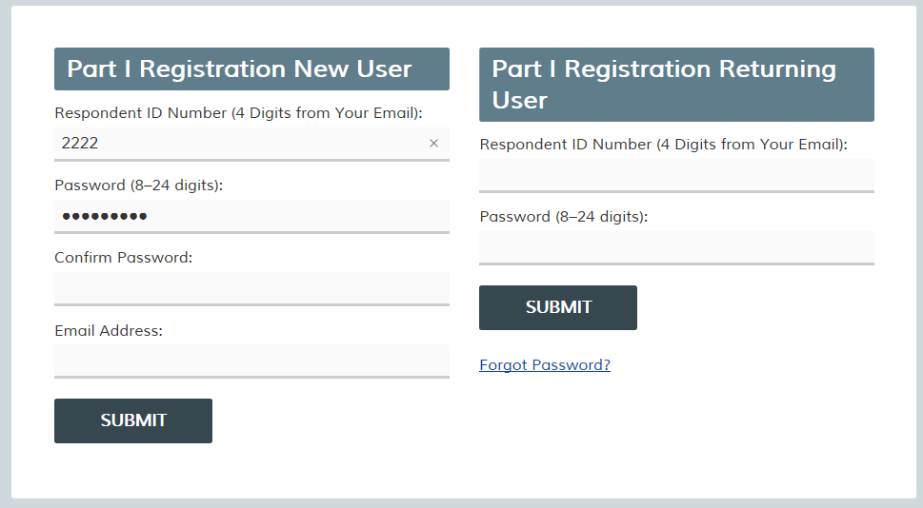
Completing the Intake Form – Part I Registration Screen

Slide 14
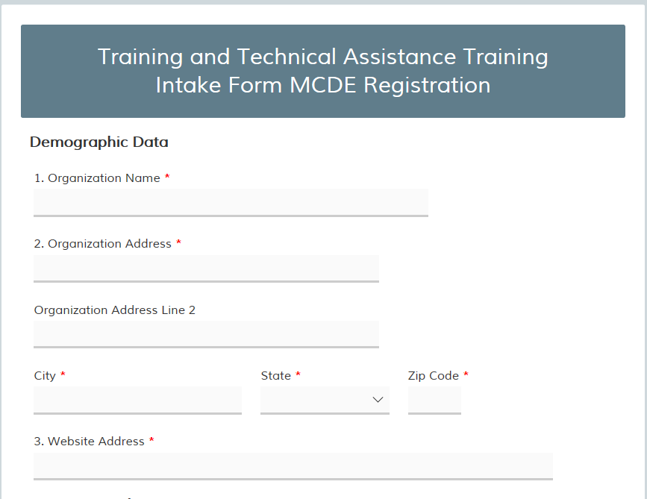
Completing the Intake Form – Part I: MCDE Registration

Slide 15
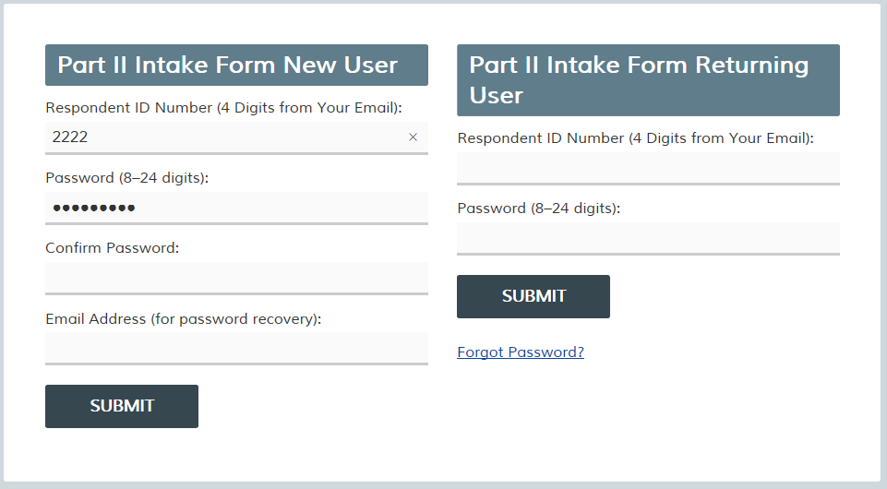
Completing the Intake Form – Part II Registration Screen

Slide 16
Completing the Intake Form – Part II: Intake Form

Slide 17
Contact Information
Questions should be emailed to:
mcdedesk@ncif.org
Questions about completing the Intake Form must be submitted no later than October 28, 2016

